Slide 1
Capstone Project: Predicting interest levels of new rental listings for RentHop
SIDHANT BHARDWAJ
MENTOR: ERIC RYNERSON

Slide 2
Problem to be solved and Motivation
Finding perfect place to rent results in browsing endless listings on the internet
Structuring and making sense of all available real estate data is hard
Using RentHop data, predictions for interest levels of new listings can be done based on the different features of the listings
Predictions will help people in narrowing down the search for apartments according to the needs
Will help RentHop identify potential listing quality issues
Will allow owners and agents to better understand renters needs and preferences

Slide 3
Features in the dataset
Bathrooms: No. of bathrooms
Bedrooms: No. of bedrooms
Display_Address: Address of the apartment
Features: List of features about the apartment
Latitude:
Longitude
Manager_id: Manager id for each listing

Slide 4
Features in the dataset
Price: Price of each apartment in USD
Building_id: building id of apartment
Description: Description about the apartment
Created: Date of the creation of listing
Interest_level: Target variable

Slide 5
Feature Engineering
Created dummy variables ( Dogs_allowed, Cats_allowed,…) from Features variable with occurrence of 1000 times
Created created_year, created_month and created_day from Created Feature
One Hot Encoded manager_id and display_address features
Created num_features, num_photos and description_words

Slide 6
Features included in model building
Bathrooms
Bedroom
Price
Display_address
Num_photos: Number of photos for each listing
Num_features: Number of features for each listing
Manager_id

Slide 7
Features included in model building
Latitude
Longitude
Created_day: Day the listing was created

Slide 8
Exploratory Data Analysis
The train data consists of 15 features ( numerical, text and categorical) and approx. 50k listings
The target variable is interest level which has 3 classes i.e. high, medium and low which is converted into two classes: high and low
Interest level for 1 bedroom is lowest and is highest for 2 bedrooms
Distribution of price found to be between 1k and 13k after removing the outliers
Low interest levels have average high prices and vice versa

Slide 9
Exploratory Data Analysis
Analyzing price, bedrooms and bathrooms shows that high interest level listings have average price of 2400 usd with 2 bedrooms and 1 bathroom
Low interest level listings have average price of 3300 usd with 1 bedroom and 1 bathroom
Addresses with most listings are Wall st, Broadway, E 34th st, …..
Most common features are Elevator, Dogs_allowed, Cats_allowed,….
Majority of the listings have atleast 3 features followed by 5
Majority of the listings have atleast 5 photos followed by 4

Slide 10
Exploratory Data Analysis
All the listings have been created during the year 2016 from April to June
Most of the listings with low interest level was created during the month of June
The high and medium interest level listings seems to have been created uniformly through the months
Most of the low level listings were created during 12 and 21 days of the months
Majority of the listings were created during the very early hours of the morning ( 1 am to 6 am)

Slide 11
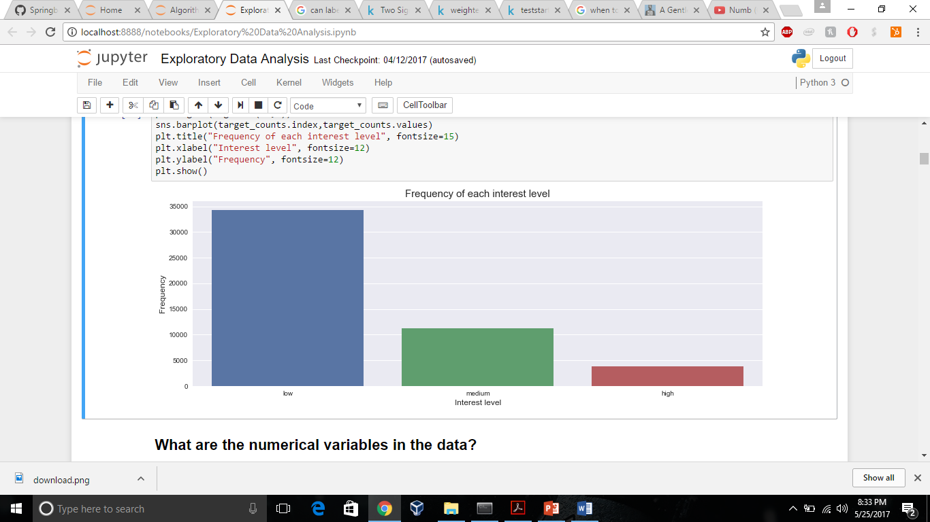
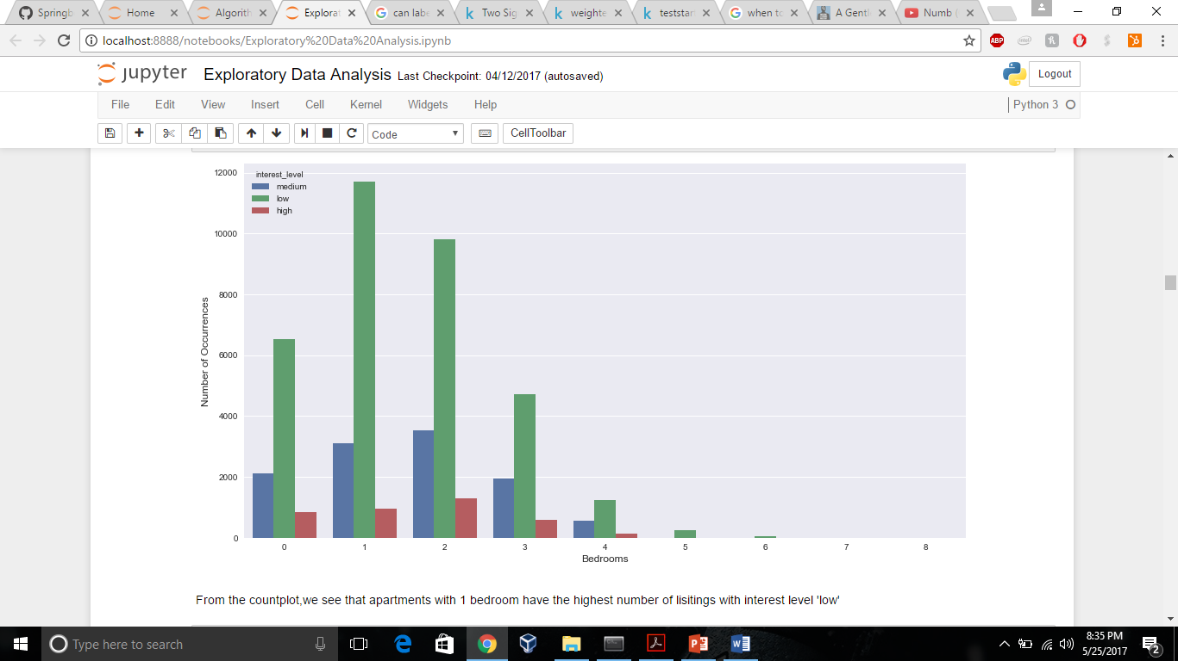
Visualizing the data

Slide 12
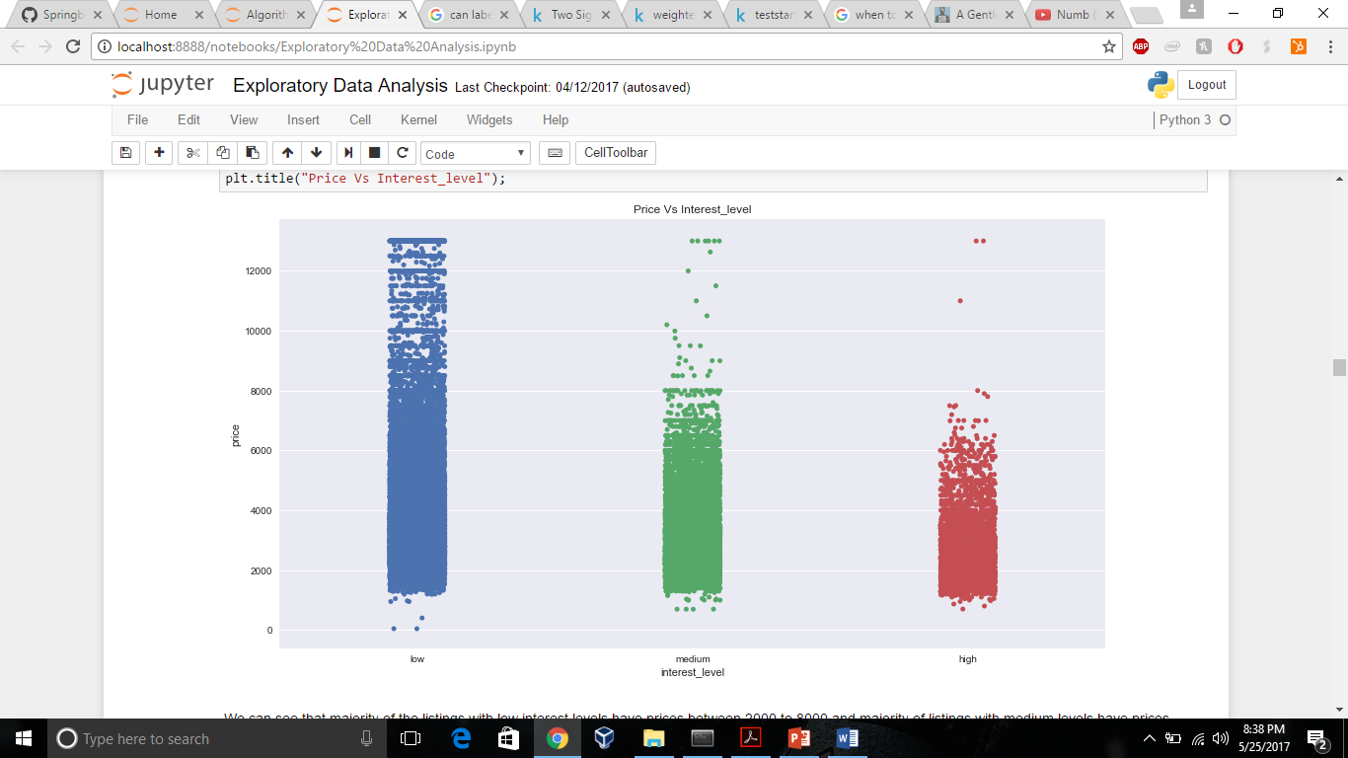

Slide 13
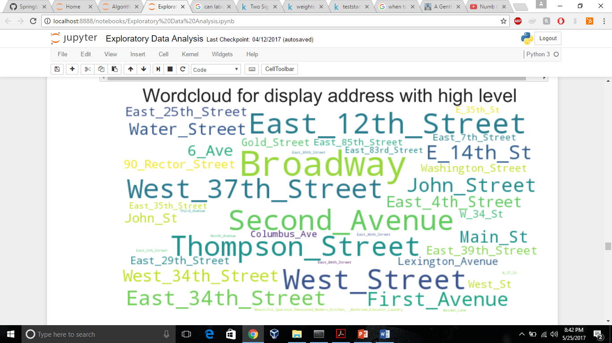
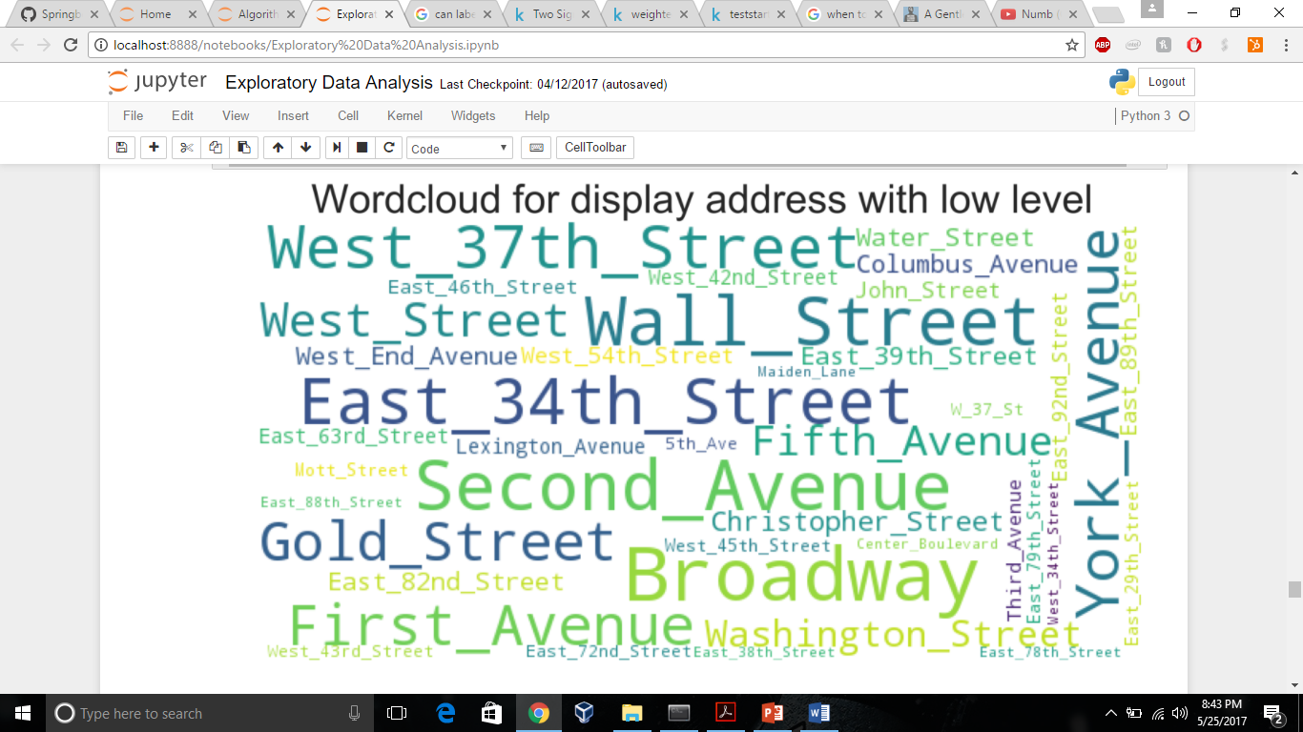
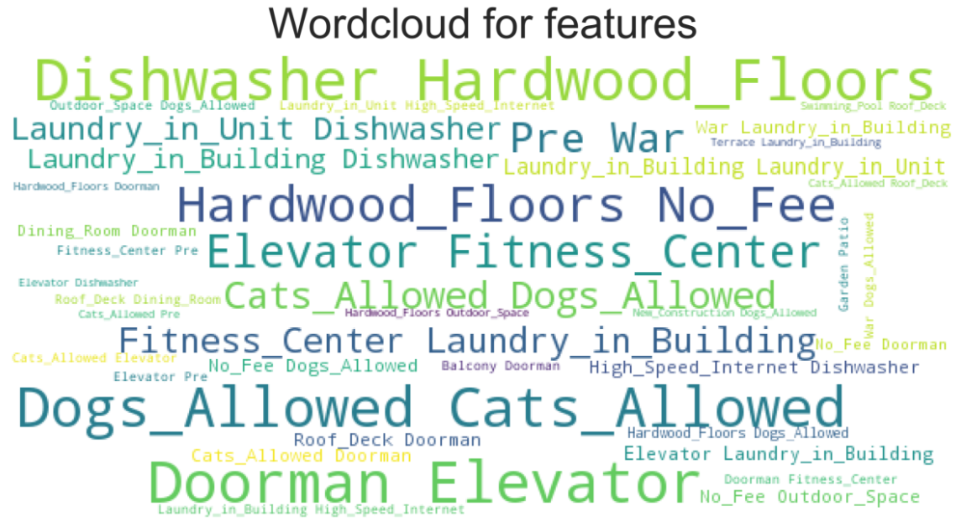

Slide 14
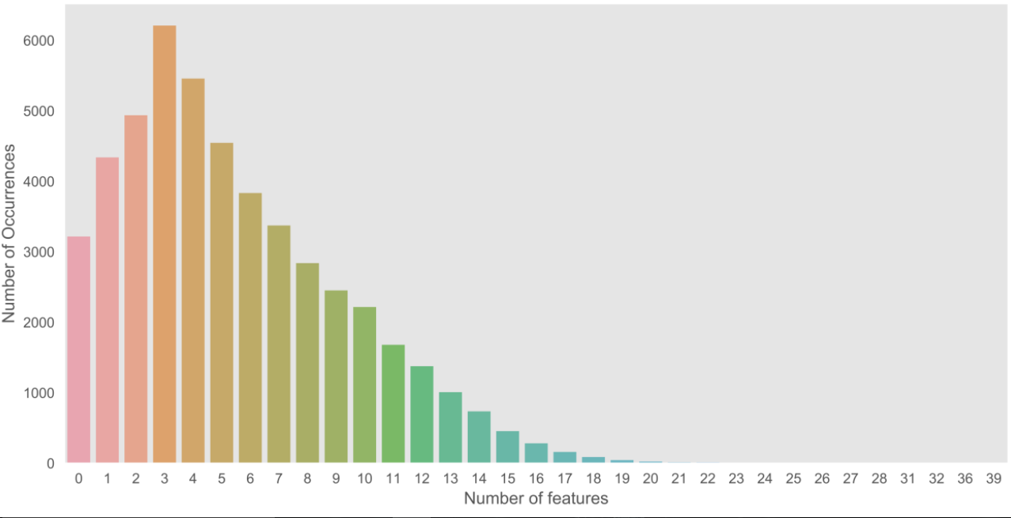
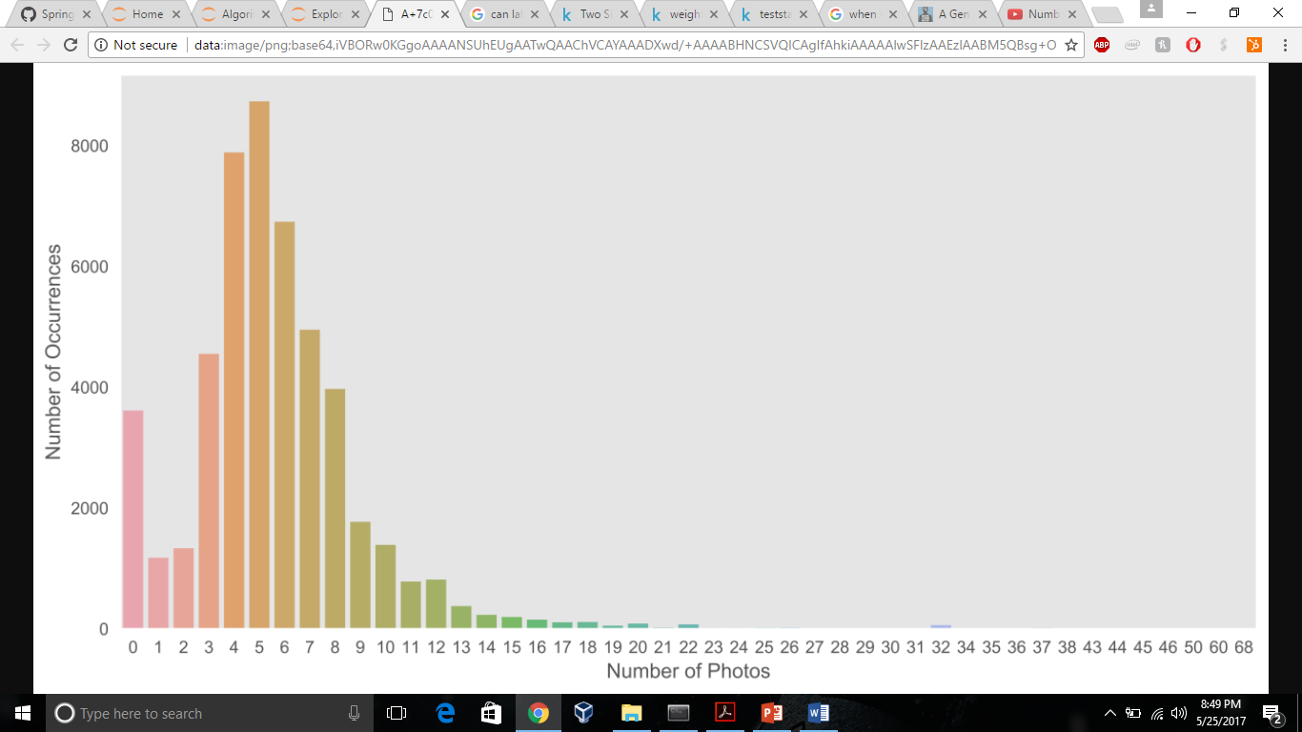
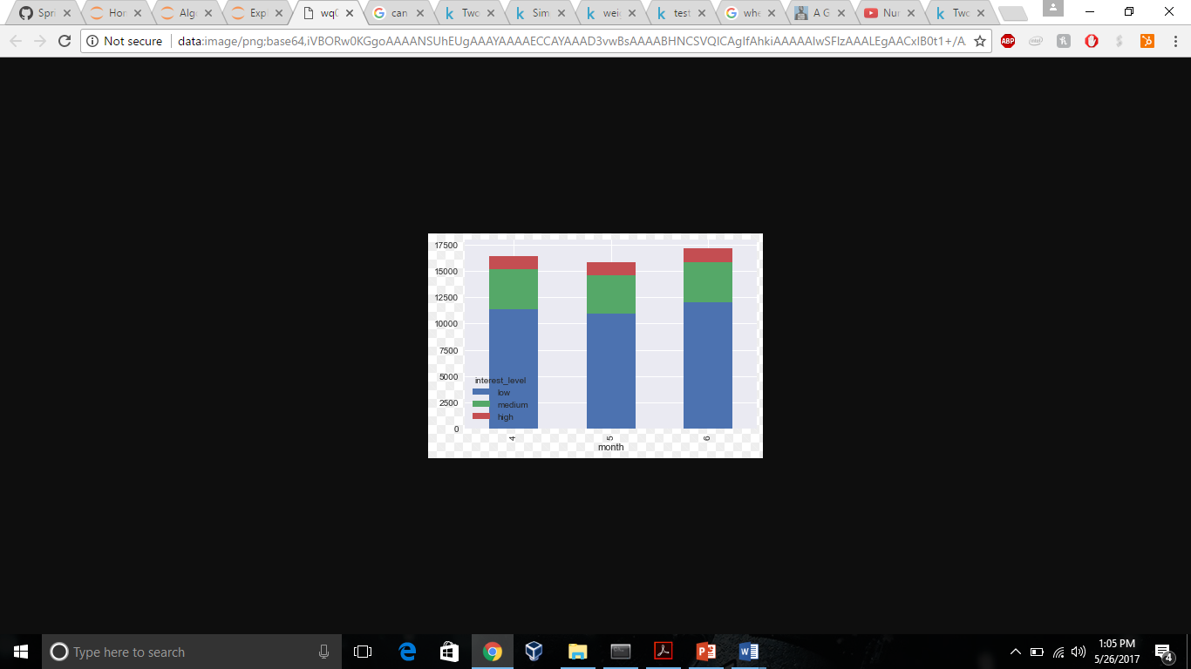
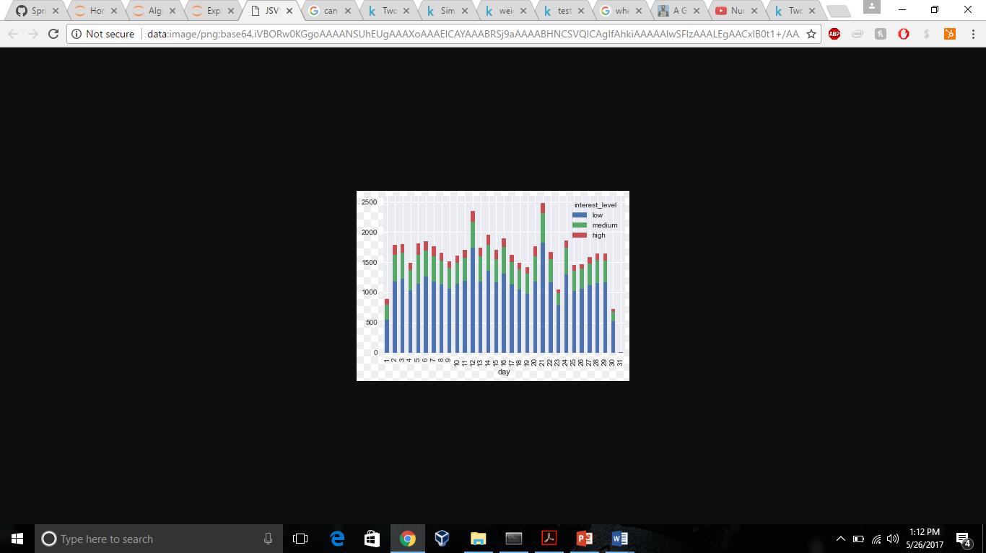

Slide 15
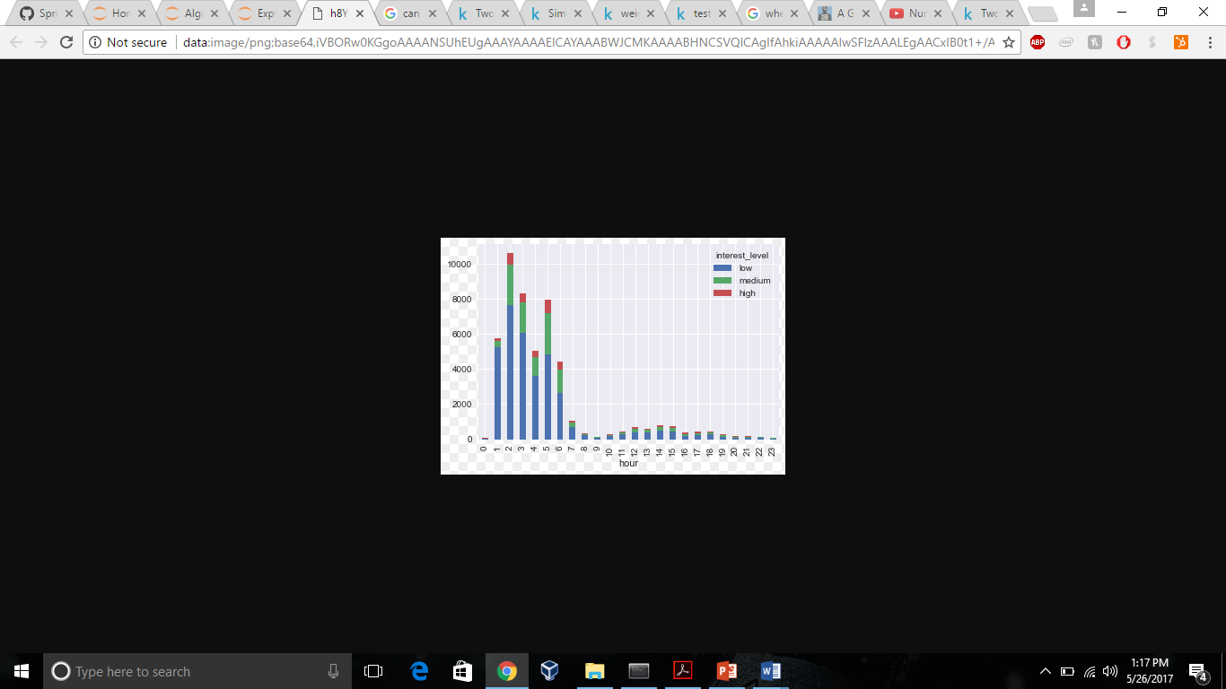

Slide 16
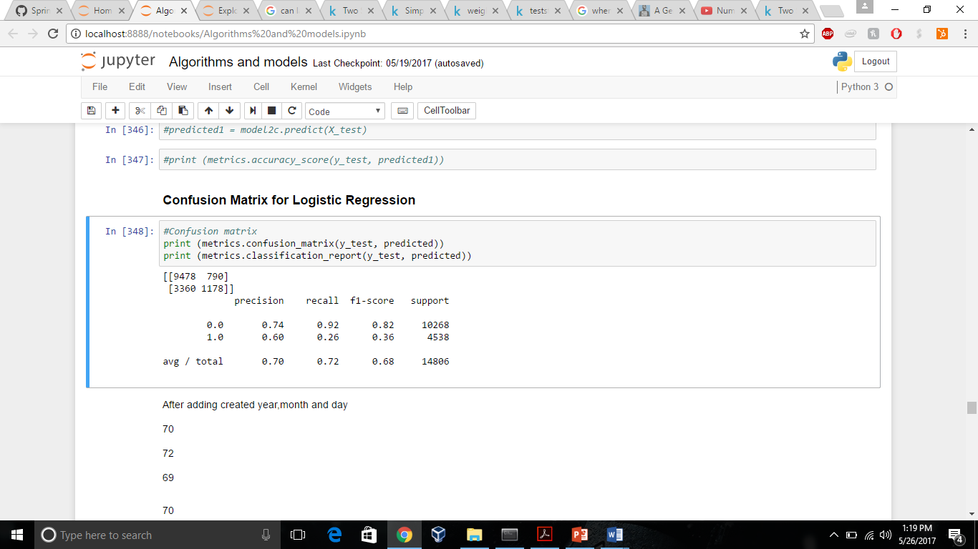

Confusion matrix

Slide 17
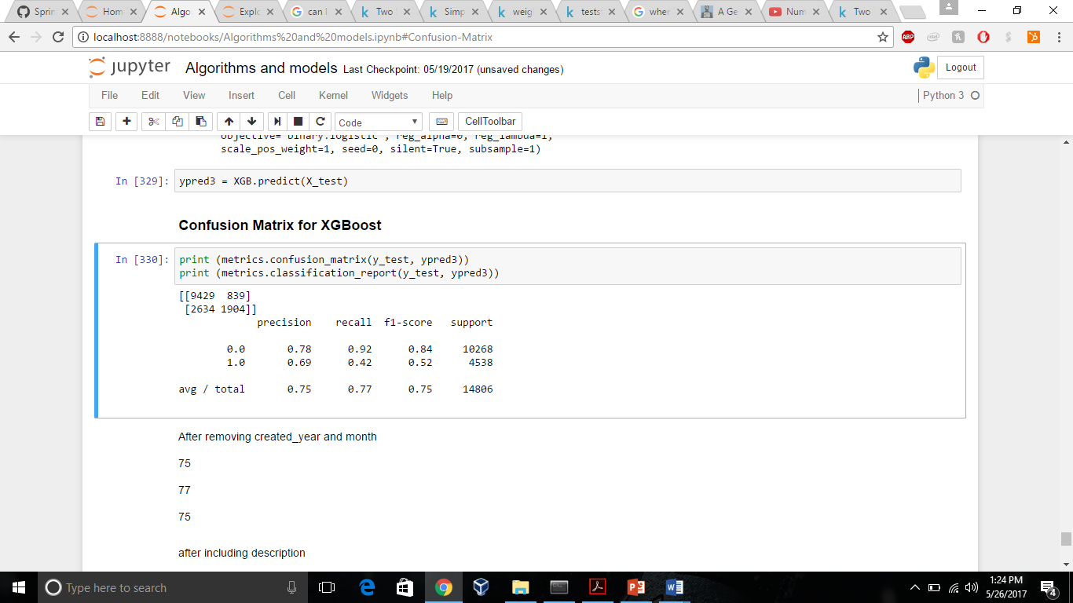
Confusion matrix

Slide 18
Algorithms and Results
Models (Algorithms) | F1 score
Logistic Regression | 0.68
SVM(RBF) | 0.62
XGBoost | 0.75

Slide 19
Future Research
Other Models: Other models can be also used for making predictions and potentially improving the score
New features: New features could be created to help us generalize better on the test data and achieving better results

Slide 20


